Slide 1
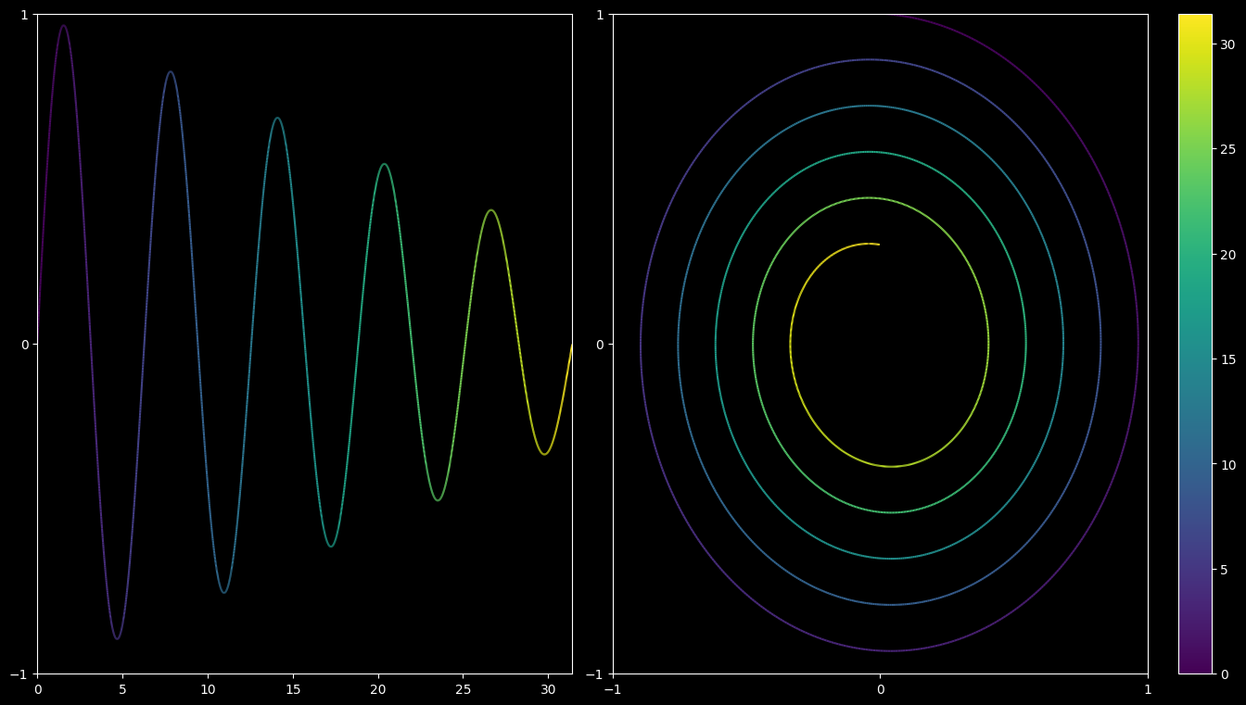
Lesson 10: Plotting
By Moritz Nesseler

Slide 2



Plotting ressources
python-graph-gallery.com
Packages
Matplotlib
Seaborn
Plotly

Slide 3
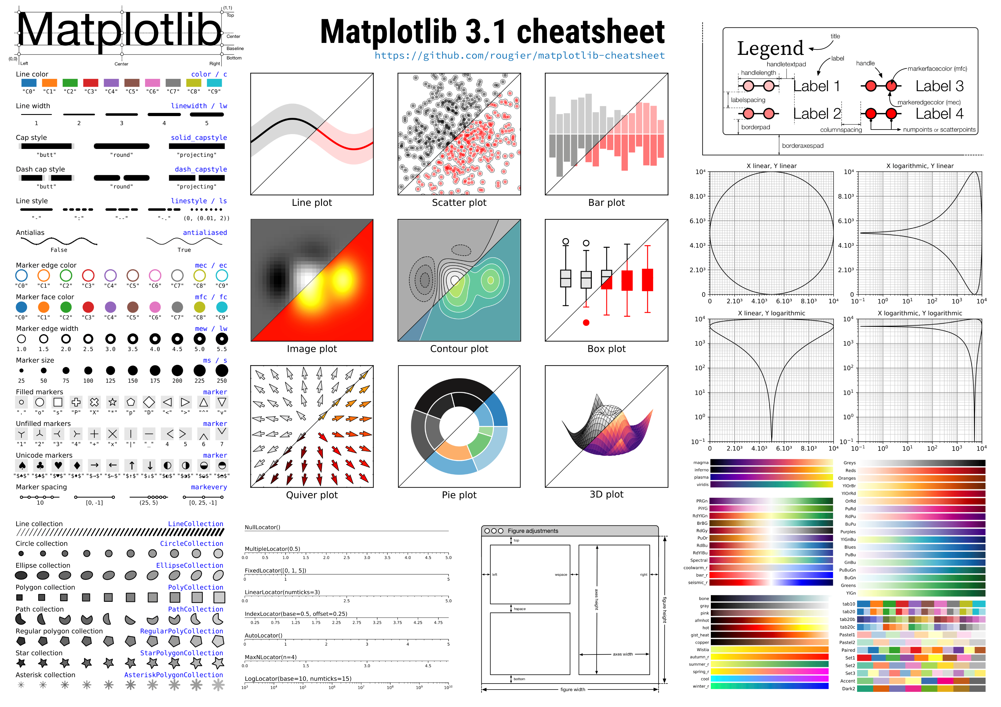

Slide 4
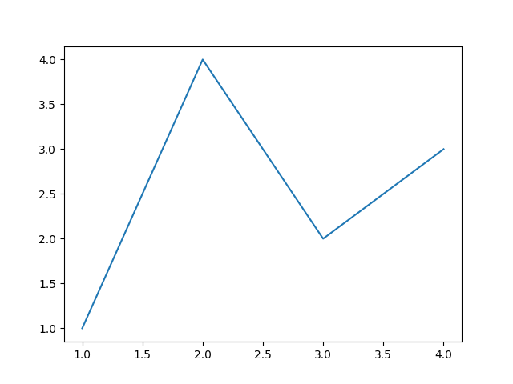
A basic plot
import matplotlib.pyplot as plt
x = [1, 2, 3, 4]
y = [1, 4, 2, 3]
fig, ax = plt.subplots()
ax.plot(x, y)
plt.show()

Slide 5
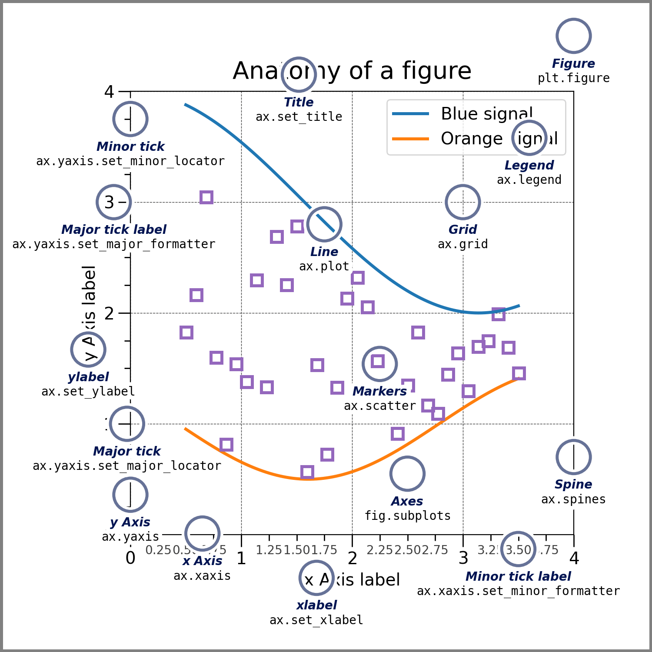
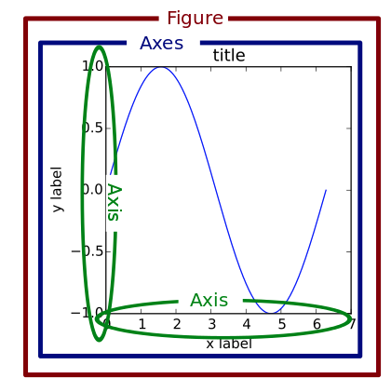
Parts of a figure

Slide 6
Parts of a figure
Figure
The whole figure. The figure keeps track of all the child Axes, a group of special Artists (titles, figure legends, colorbars, etc.), and even nested subfigures.
For subplots use plt.subplots() or plt.subplot_mosaic()
Axes
An Axes is an Artist attached to a Figure that contains a region for plotting data and usually includes two (or three in the case of 3D) Axis objects.
The Axes methods are the primary interface for configuring most parts of your plot (adding data, controlling axis scales and limits, adding labels etc.).
Axis
These objects set the scale and limits and generate ticks (the marks on the Axis) and ticklabels (strings labeling the ticks).

Slide 7
Parts of a figure
Artists
Basically, everything visible on the Figure is an Artist (even Figure, Axes, and Axis objects). This includes Text objects, Line2D objects, collections objects, Patch objects, etc. When the Figure is rendered, all of the Artists are drawn to the canvas. Most Artists are tied to an Axes; such an Artist cannot be shared by multiple Axes, or moved from one to another.

Slide 8
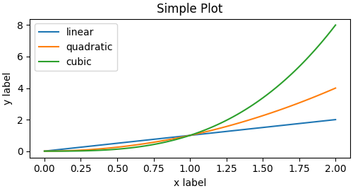
Matplotlib Coding Styles – Explicit vs Implicit
import matplotlib.pyplot as plt
import numpy as np
x = np.linspace(0, 2, 100)
plt.figure(figsize=(5, 2.7), layout='constrained')
plt.plot(x, x, label='linear')
plt.plot(x, x**2, label='quadratic')
plt.plot(x, x**3, label='cubic')
plt.xlabel('x label')
plt.ylabel('y label')
plt.title('Simple Plot')
plt.legend()
plt.show()

Slide 9
Matplotlib Coding Styles – Explicit vs Implicit
import matplotlib.pyplot as plt
import numpy as np
x = np.linspace(0, 2, 100)
fig, ax = plt.subplots(figsize=(5, 2.7), layout='constrained')
ax.plot(x, x, label='linear')
ax.plot(x, x**2, label='quadratic')
ax.plot(x, x**3, label='cubic')
ax.set_xlabel('x label')
ax.set_ylabel('y label')
ax.set_title('Simple Plot')
ax.legend()
plt.show()
Get current axes
ax = plt.gca()

Slide 10
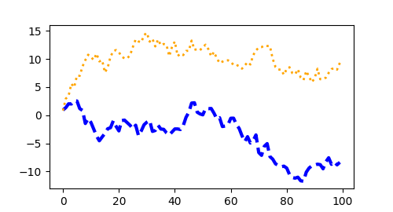
Styling Artists
import matplotlib.pyplot as plt
import numpy as np
data1, data2 = np.random.randn(4, 100)
x = np.arange(len(data1))
fig, ax = plt.subplots(figsize=(5, 2.7))
ax.plot(x, np.cumsum(data1),
color='blue',
linewidth=3,
linestyle='--')
l, = ax.plot(x, np.cumsum(data2),
color='orange',
linewidth=2)
l.set_linestyle(':')
plt.show()

Slide 11
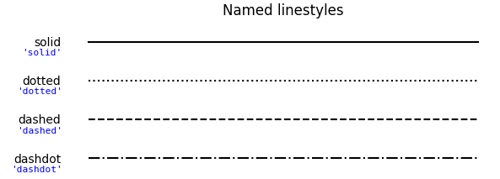
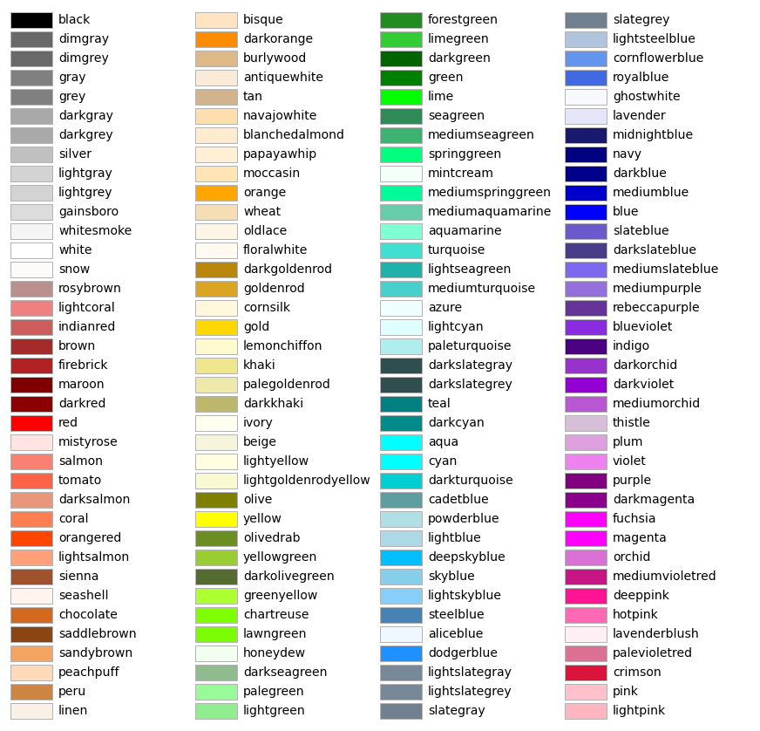

Styling Artists – LineStyles & Colors

Slide 12
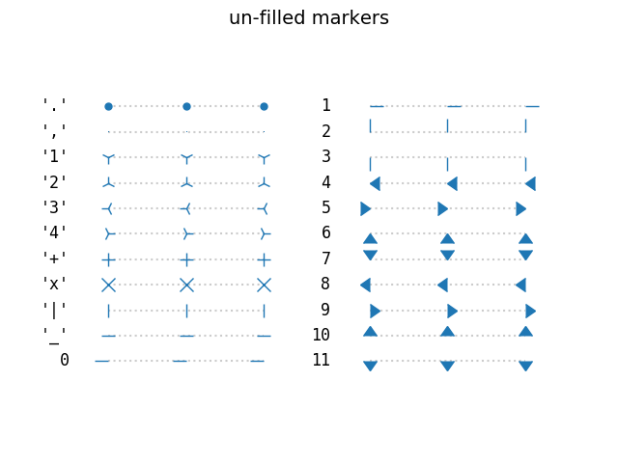
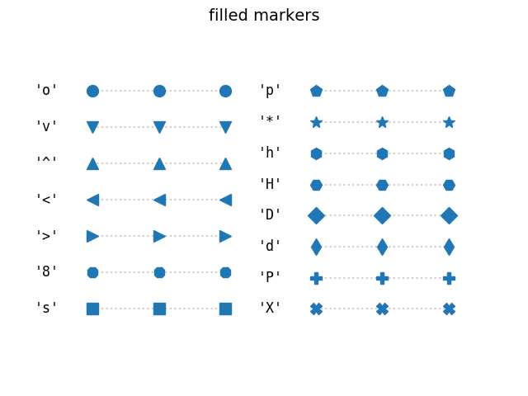
Styling Artists – Markers

Slide 13
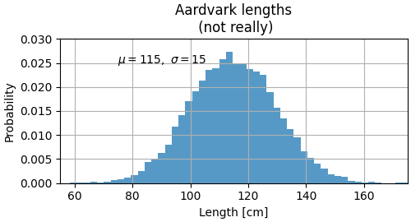
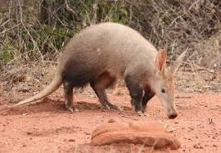
Labelling plots – Axes labels and annotation
mu, sigma = 115, 15
x = mu + sigma * np.random.randn(10000)
fig, ax = plt.subplots(figsize=(5, 2.7), layout='constrained')
n, bins, patches = ax.hist(x, 50,
density=True,
facecolor='C0',
alpha=0.75)
ax.set_xlabel('Length [cm]')
ax.set_xlabel('Probability')
ax.set_title('Aardvark lengths\n (not really)')
ax.text(75, .025, r'$\mu=115,\ \sigma=15$')
ax.axis([55, 175, 0, 0.03])
ax.grid(True)

Slide 14
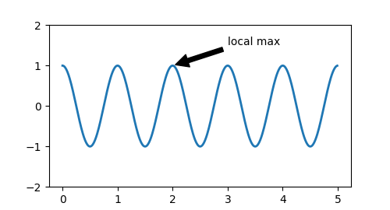
Annotation
fig, ax = plt.subplots(figsize=(5, 2.7))
t = np.arange(0.0, 5.0, 0.01)
s = np.cos(2 * np.pi * t)
line, = ax.plot(t, s, lw=2)
ax.annotate('local max', xy=(2, 1), xytext=(3, 1.5),
arrowprops=dict(facecolor='black',
shrink=0.05))
ax.set_ylim(-2, 2)
plt.show()

Slide 15
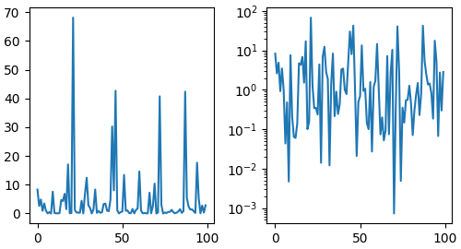
Subplots
fig, axs = plt.subplots(nrows = 1,
ncols = 2,
figsize=(5, 2.7),
layout='constrained')
xdata = np.arange(len(data1))
data = 10**data1
axs[0].plot(xdata, data)
axs[1].set_yscale('log')
axs[1].plot(xdata, data)
plt.show()

Slide 16
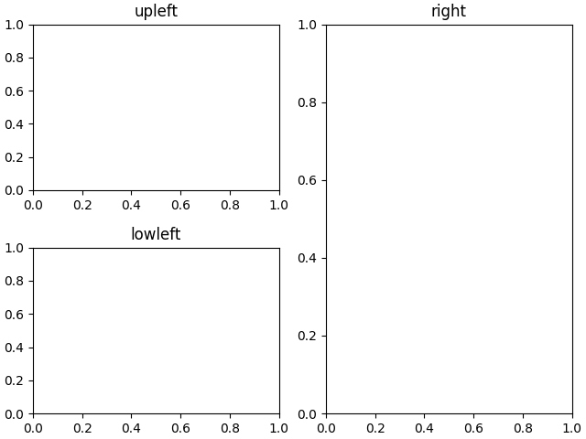
Subplots mosaic
fig, axd = plt.subplot_mosaic([['upleft', 'right'],
['lowleft', 'right']], layout='constrained')
axd['upleft'].set_title('upleft')
axd['lowleft'].set_title('lowleft')
axd['right'].set_title('right')
plt.show()

Slide 17
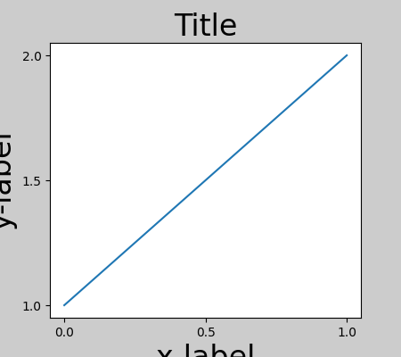
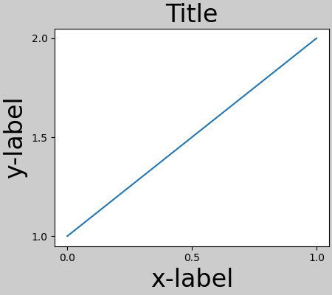
Layouts
Default
Constrained

Slide 18
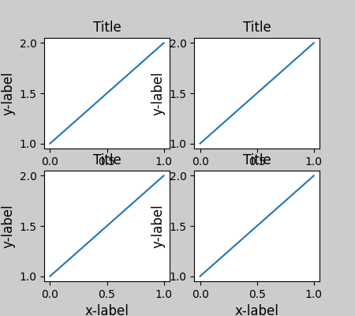
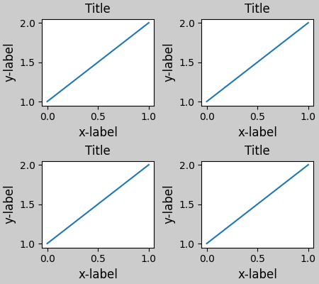
Layouts
Default
Constrained

Slide 19
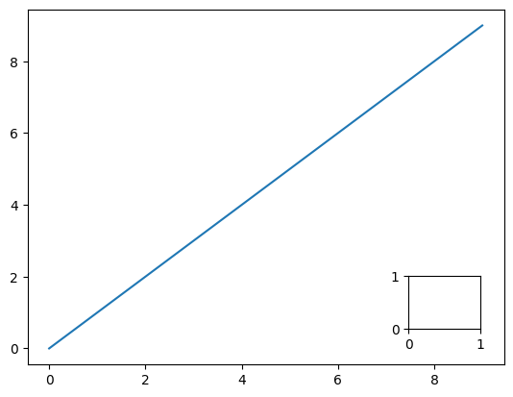
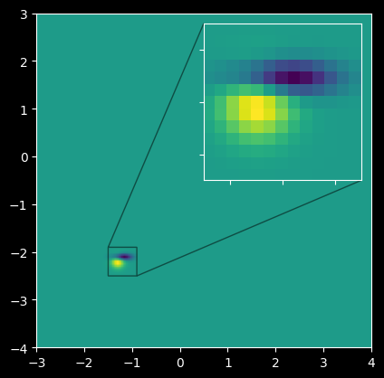
Inset axes
fig, ax = plt.subplots()
ax.plot(range(10))
Ax_inset = ax.inset_axes([0.8, 0.1, 0.15, 0.15])
plt.show()

Slide 20
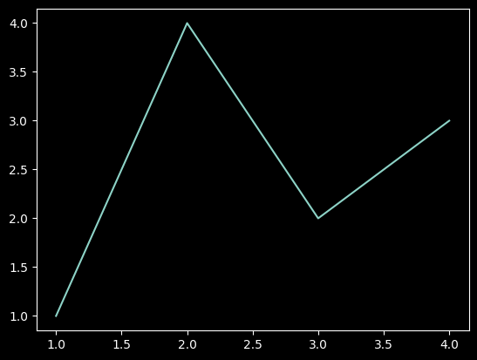
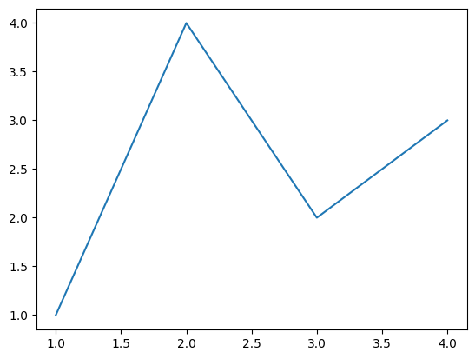
The most important line of code for plots
plt.style.use('dark_background')

Slide 21
The most important line of code for plots
plt.style.use('dark_background')

Slide 22
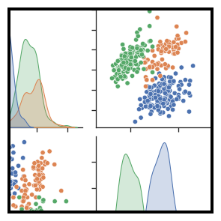
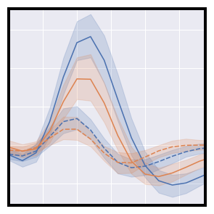
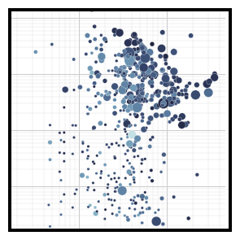
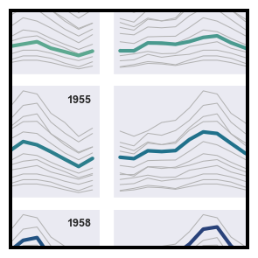
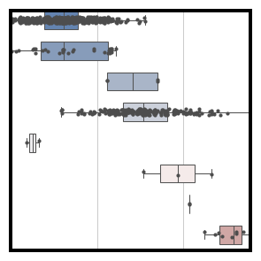
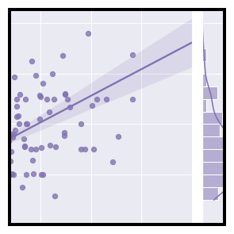
Seaborn – Pandas integration
Seaborn is a library for making statistical graphics in Python. It builds on top of matplotlib and integrates closely with pandas data structures.
import seaborn as sns

Slide 23
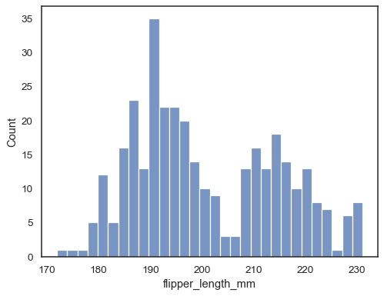
Pandas useful plotting functions
Histplot
sns.histplot(data=df, x="flipper_length_mm", bins=30)

Slide 24
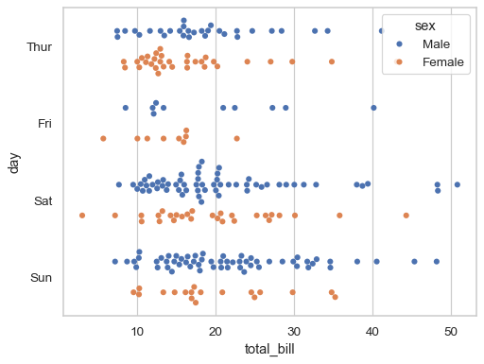
Pandas useful plotting functions
Swarmplot
sns.swarmplot(data=df, x=“total_bill", y=“day", hue=“sex“, dodge=True)

Slide 25
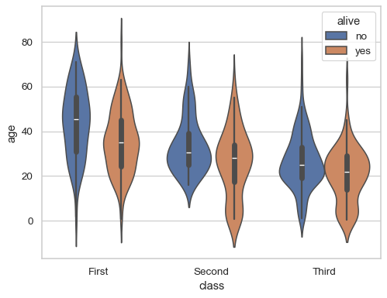
Pandas useful plotting functions
Violinplot
sns.violinplot(data=df, x="class", y="age", hue="alive")

Slide 26
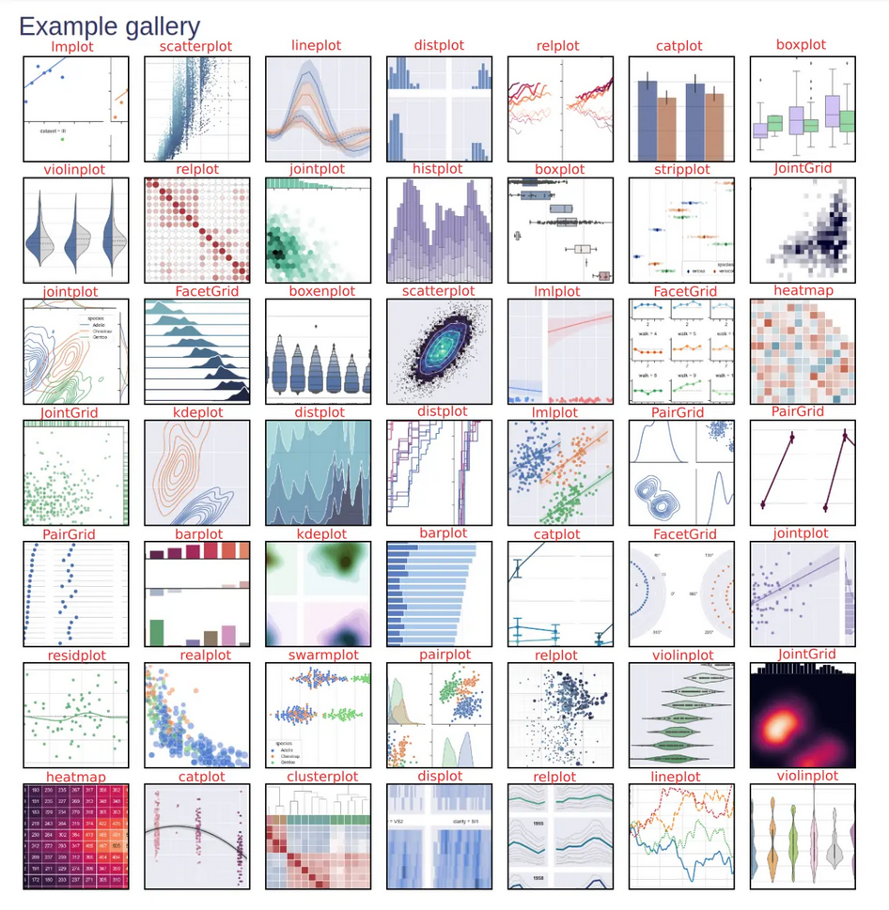

Slide 27
